Slide 1
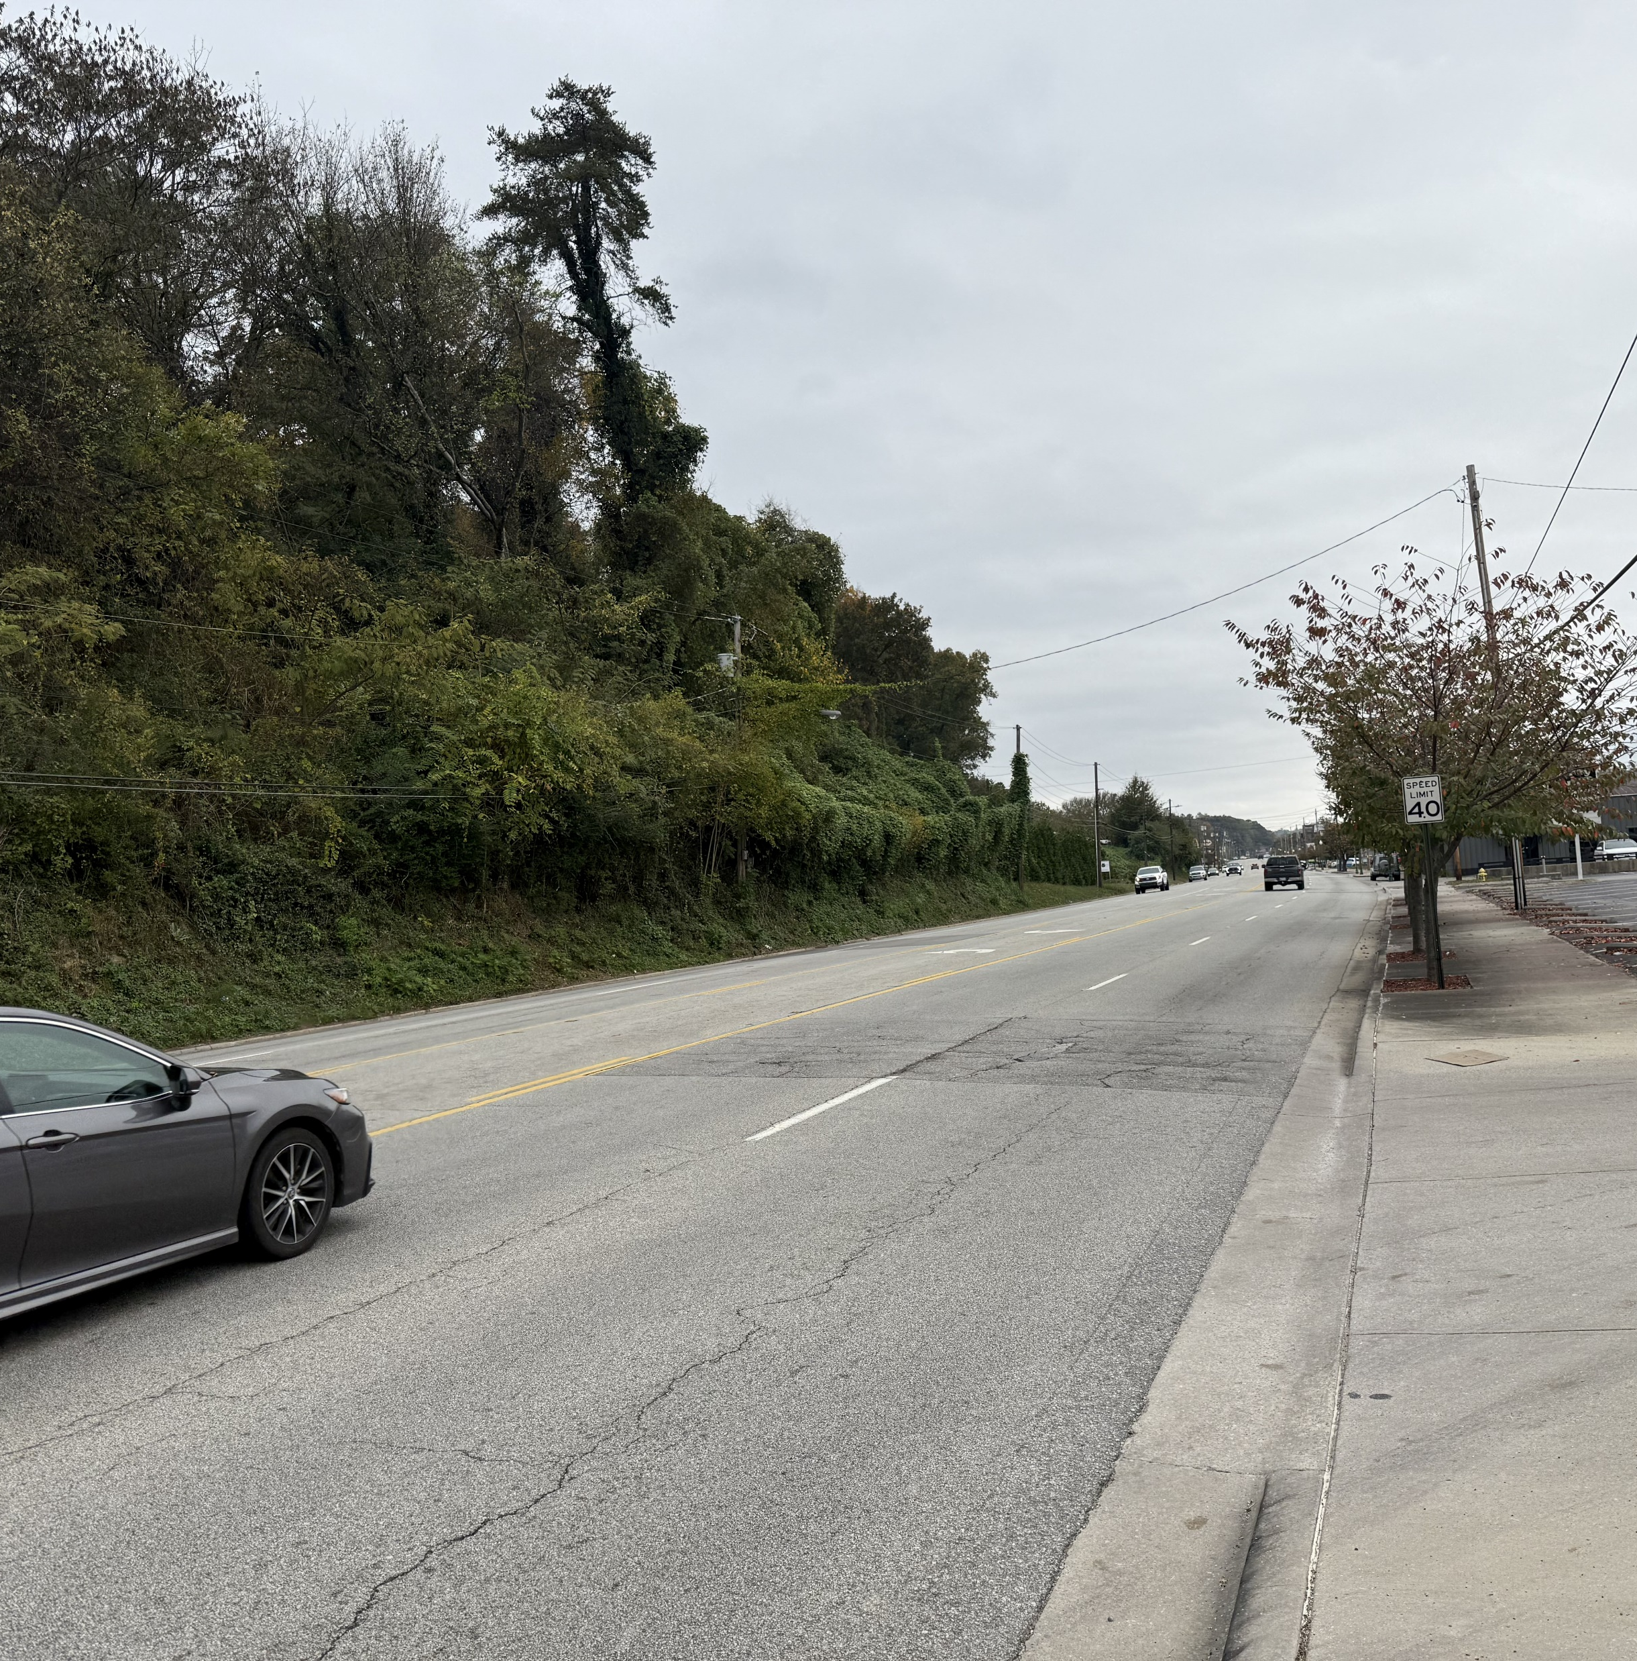
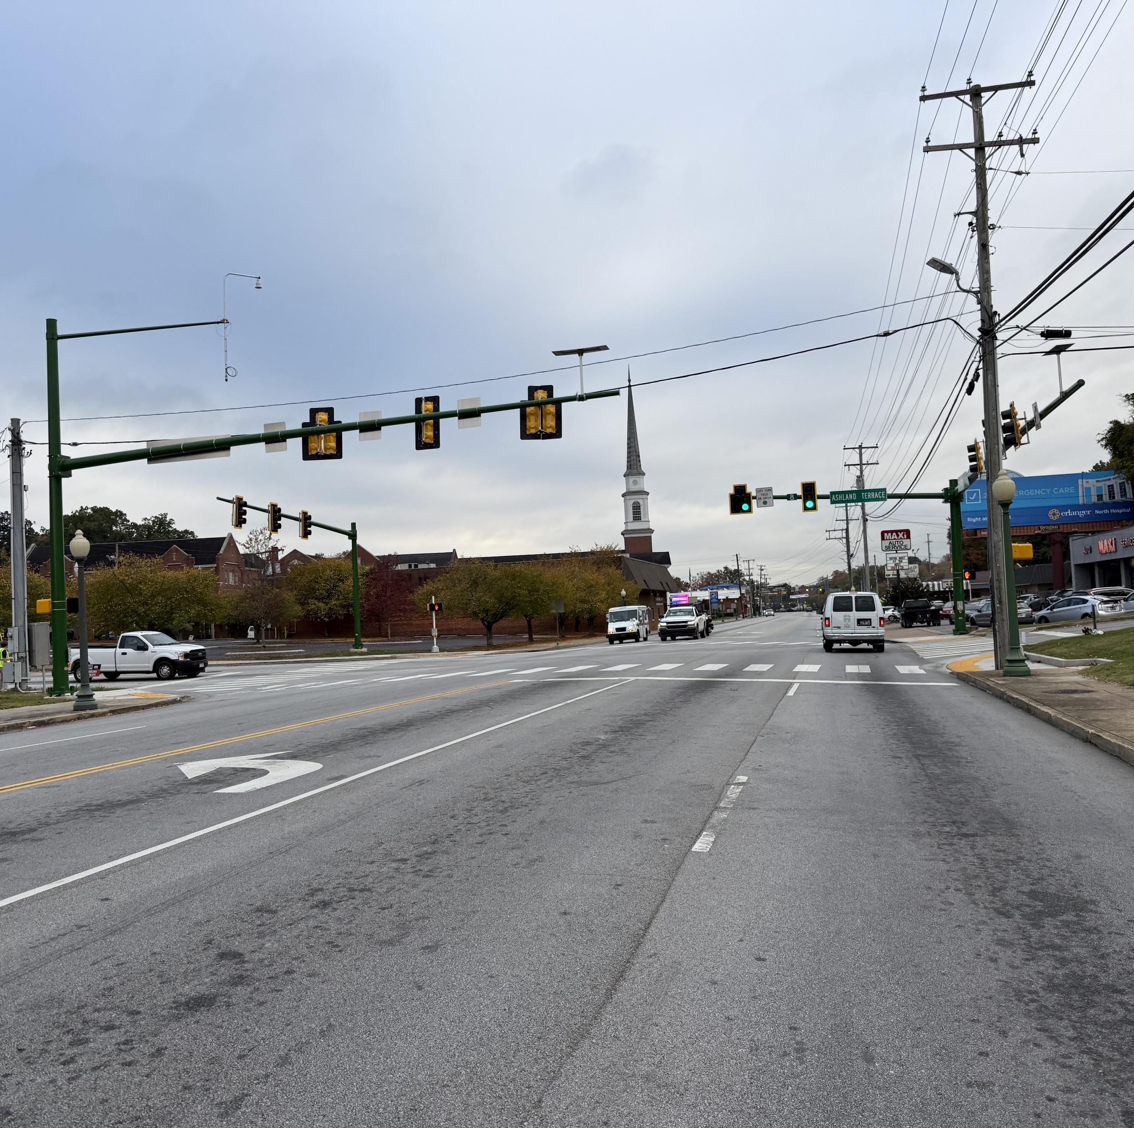




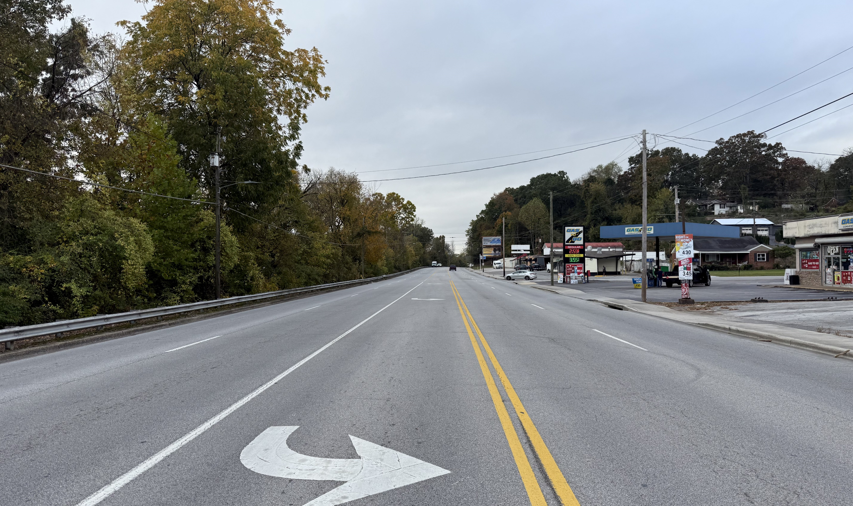
Dayton Boulevard ‘Right Sizing’ Study
From Signal Mountain Road to Gadd Road
Funded in part by the Tennessee Department of Heath – Healthy Built Environment Grant
Notes:
Right click on photo to upload a new photo.

Slide 2
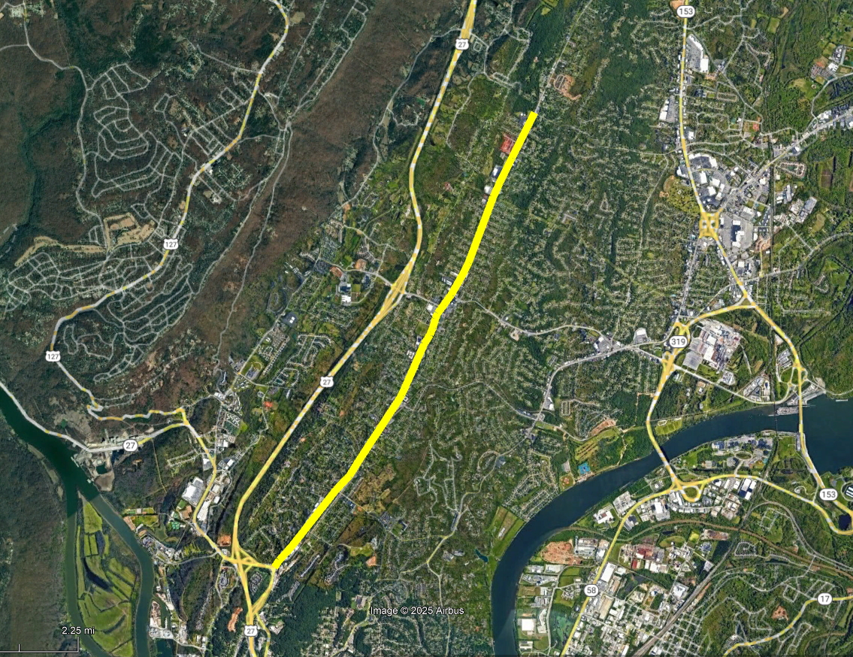

Project Grant Funding
Tennessee Department of Health
2024 Healthy Built Environment Grant Recipient
$50,000 grant to complete a Right Sizing Feasibility study for Dayton Boulevard
Grant goals include promoting health equity by providing ways for increased activity for local residents, resulting in improved physical and mental health of citizens

Slide 3
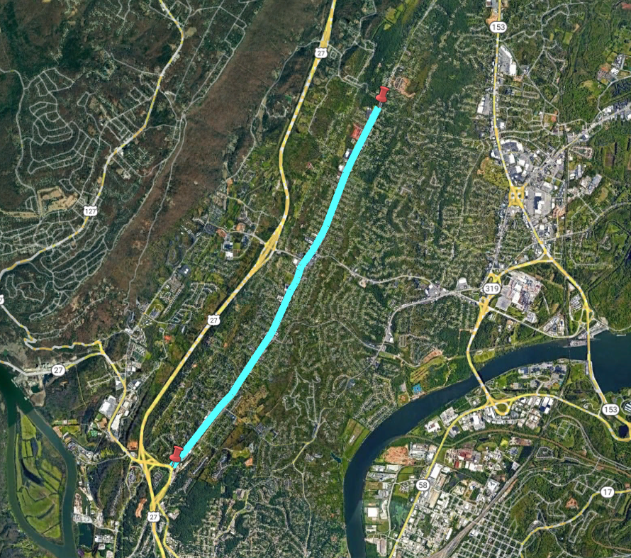
Project Overview
Project Limits:
Dayton Boulevard from Signal Mountain Road to Gadd Road
Project Goals:
Analyze existing traffic conditions
Determine improvements for more efficient traffic operations
Develop improved lane configuration to promote alternate transportation modes (pedestrian / bicycle), improve quality and viability of the corridor, and provide beautification opportunities for landscaping and street trees
Morrison Springs Rd
SR 153
Ashland Terrace
Highway 27
Dayton Blvd

Slide 4
Project Methodology / Analysis
Project Methodology:
Feasibility study conducted in accordance with TDOT’s Road Diet Guidance Manual, May 2023
Investigated existing traffic conditions along Dayton Boulevard
Applied TDOT’s Road Diet analysis process to analyze existing and projected future roadway conditions
Analyzed existing crash trends along the corridor, specifically regarding pedestrians / bicyclists
Literature review of existing Red Bank plans/studies to ensure project aligns with City’s mission and objectives
Notes:
Outline sub tasks required by TDOT Road Diet Guidance manual

Slide 5
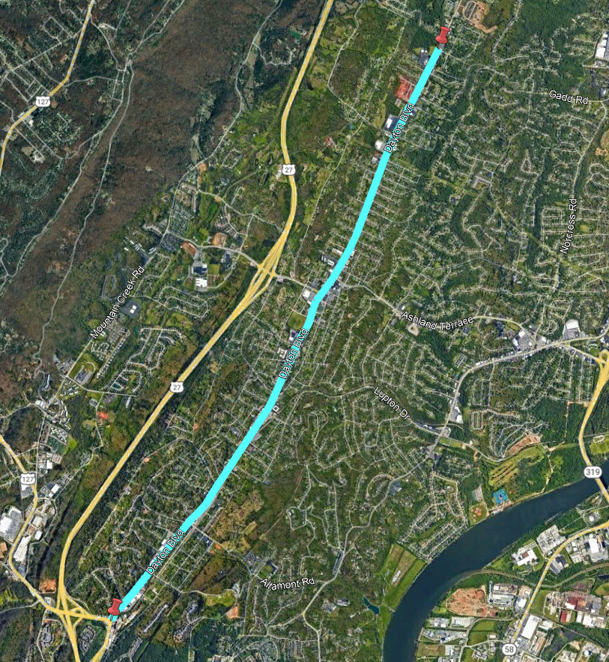
Summary Findings
Existing Traffic Conditions
Two segments of Dayton Boulevard with crash rates that exceed statewide averages
Morrison Springs Road to Ashland Terrace
Signal Mountain Road to Hedgewood Drive
Signal timings operating ‘individually’ rather than ‘in coordination’
Traffic can move more efficiently with less queueing when coordinated as a system
Large sidewalk gaps for pedestrian connectivity
Sidewalk abruptly ends, providing no connection for walking pedestrians
Mid-block crossings spaced far apart along corridor
Notes:
Most crashes are happening at segments (62%) not intersections (38%)
Sidewalk gaps located:
Gadd Road to Flash Way
Driver Services building to Browntown Road
Spring Road to Signal Mountain Road

Slide 6
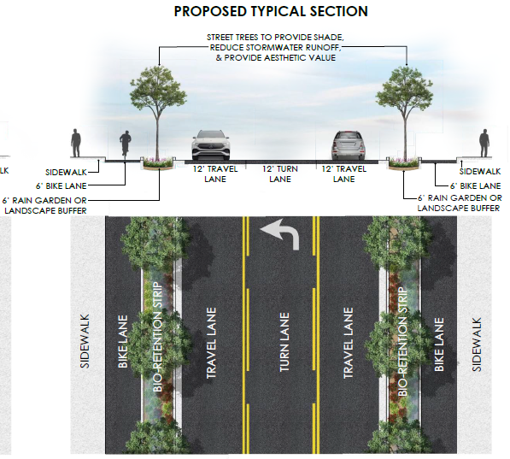
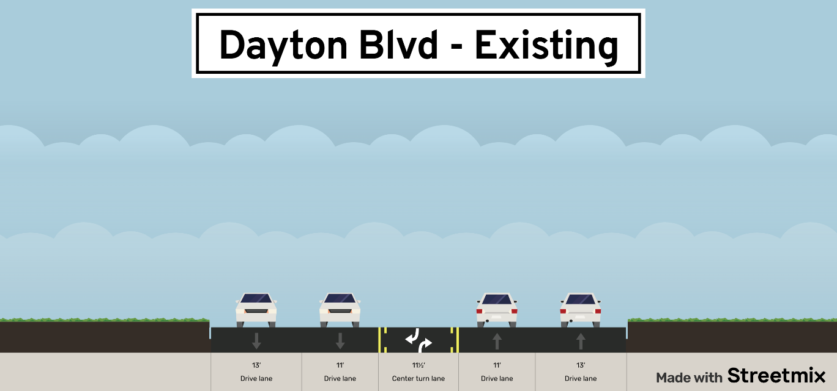
Summary Findings
It IS feasible to reconfigure Dayton Boulevard from a 5-lane roadway to a 3-lane roadway
Reconfigured roadway can include 3 vehicle travel lanes and buffered bicycle lanes
13’
11’
11.5’
11’
13’
Notes:
Transition from last slide – ‘roadway has potential to be more efficient for all users’
Typical section that could be expected for Dayton;
A few segments will differ – Morrison Springs/Ashland Terrace (will share if prompted)
Opportunity to incorporate stormwater management along Dayton
Highlight more median greenscaping opportunities

Slide 7
Operational Recommendations
Signal Timings
Coordinating signal timing optimization along Dayton Boulevard is essential to ensure efficient vehicle progression and enable corridor-wide signal integration as a unified, holistic system.
More green time, less ‘stop and go’ along the corridor
Traffic signal timings should be customized for different commuting hours of the day
New Speed Limit
Reduce speed limit to 35 mph along entire length of Dayton Boulevard
Federal recommendations suggest reducing speeds for bicycles/pedestrians (FHWA-SA-21-034)
Increase safety for all users along the roadway

Slide 8
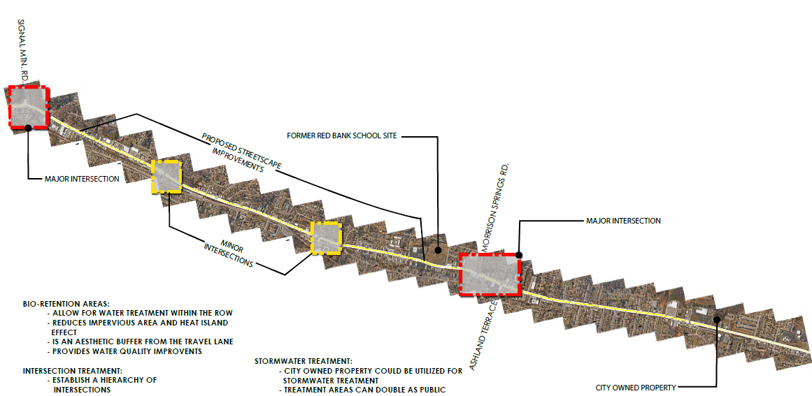
Project Pros / Cons
Pros
Corridor will function more as a ‘main street’ as opposed to a high speed ‘highway’
More equitable share of mobility for all users (vehicle / pedestrian / bicyclists)
Provide stronger connection North/South/East/West throughout all of Red Bank for walking / bicycling
Adheres to City’s and citizens’ desire for a more viable, connected corridor
Cons
Vehicles will be prioritized less, sharing mobility with other modes of travel
Longer vehicle queues will occur, especially during commuting hours
Vehicles on side streets will wait longer to access Dayton Boulevard
Notes:
Highest queues of ~62 cars in the AM at Hedgewood;~35 cars in the PM at Hedgewood
Sidestreet roads could see increase in ‘wait time’ of 30-40 seconds
On average, overall intersection delay stays relatively the same (within 10 seconds of ‘wait time’)

Slide 9
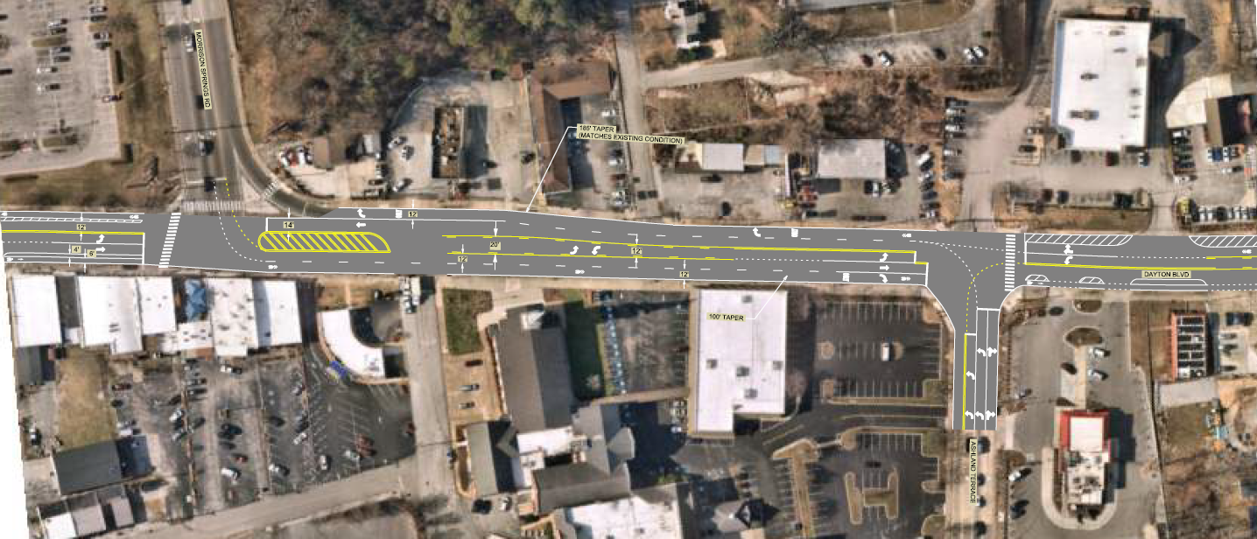

Critical Intersections
Morrison Springs Road / Ashland Terrace
Morrison Springs Rd
Dayton Blvd
Ashland Terrace
Notes:
Existing lanes are necessary to remain due to heavy left turning vehicles to/from Morrison Springs;
Bicyclists will share travel lanes with vehicles between intersections;
In addition, other studies are analyzing various other improvements can occur at both intersections (WO1 recommendations include pedestrian improvements at Morrison Springs)

Slide 10
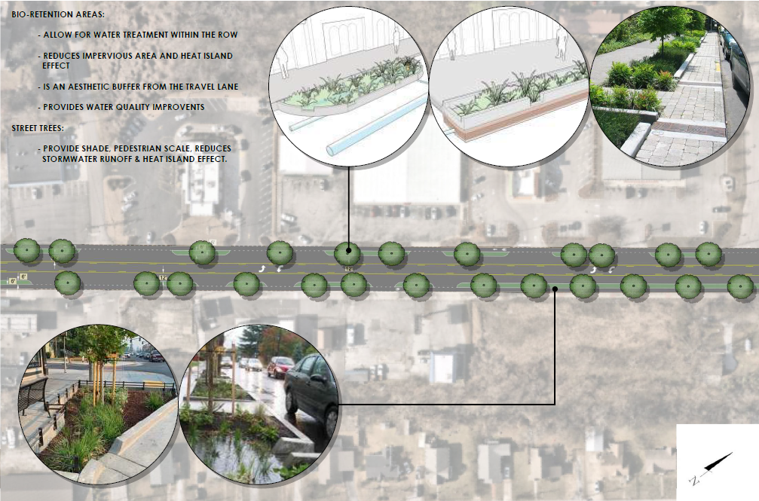
Next Steps
City can use feasibility study as a tool for funding opportunity for design
City can begin designing new corridor
Cross section details / buffered space opportunities can be refined
Notes:
Highlight stormwater opportunity for Dayton Blvd to contribute to Stringers Branch mitigation

Slide 11




Questions

Slide 12
1110 Market Street // SUITE 200 Chattanooga // Tennessee // 37402
Phone // 423-756-3025 // BargeDesign.com

